Slide 1
Report Guidelines
As this course will be using Gradescope to grade reports, the number of slides needs to match with the template that we provide. It is imperative that you provide the answers in the designated space. Please do not change the template or add additional slides. Assignments will not be graded if answers appear in the wrong location.
Each image should be 2MB or lesser before being pasted in the template. This is done to reduce file size and make grading easier.
Questions will be in blue. Please do not remove the questions from the slides.
We expect thoughtful answers that provide clear explanations. Short, one line answers will not receive the full score. Your answers should ideally fit in the space provided.
When you are done, convert your template report to a PDF and then check it to see if it looks okay! Students often end up with lines cut off on slide bottoms. We can only grade what appears in the report.
DELETE THIS SLIDE BEFORE YOU SUBMIT

Slide 2
Computer Vision
(TERM YEAR)
Problem Set #2
First Name Last Name
Email Address
Computer Vision @ GT

Slide 3
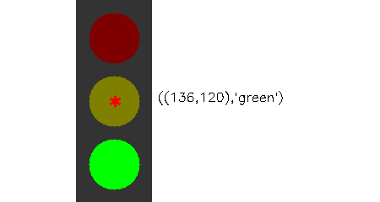
Traffic Light Detection
Coordinates and State:
Coordinates: (136, 120)
State: green
ps2-1-a-1.png

Slide 4
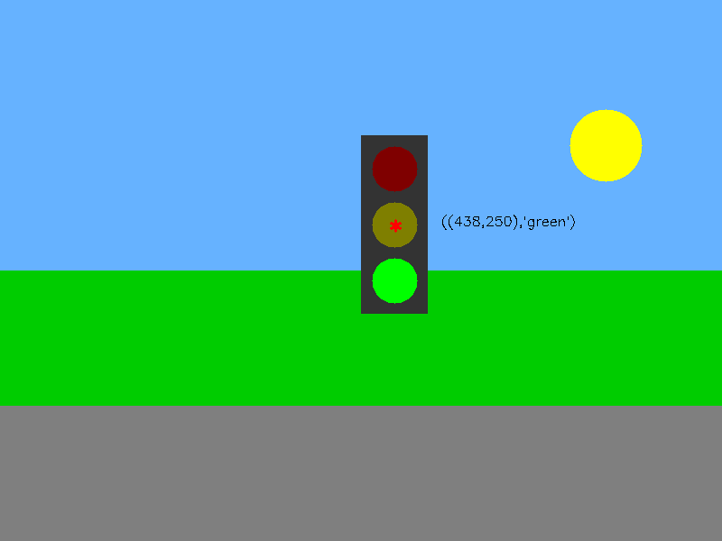
Traffic Light Detection
Coordinates and State:
Coordinates: 438, 250
State: green
ps2-1-a-2.png

Slide 5
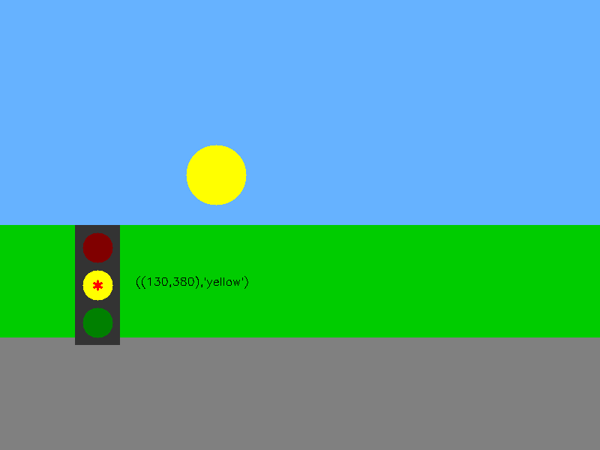
Traffic Light Detection
Coordinates and State:
Coordinates: 130,380
State: yellow
ps2-1-a-3.png

Slide 6

Traffic Light Detection
Coordinates and State:
Coordinates: 630, 480
State: red
ps2-1-a-4.png

Slide 7

Traffic Sign Detection - Do Not Enter
Coordinates: 246, 346
ps2-2-a-1.png

Slide 8
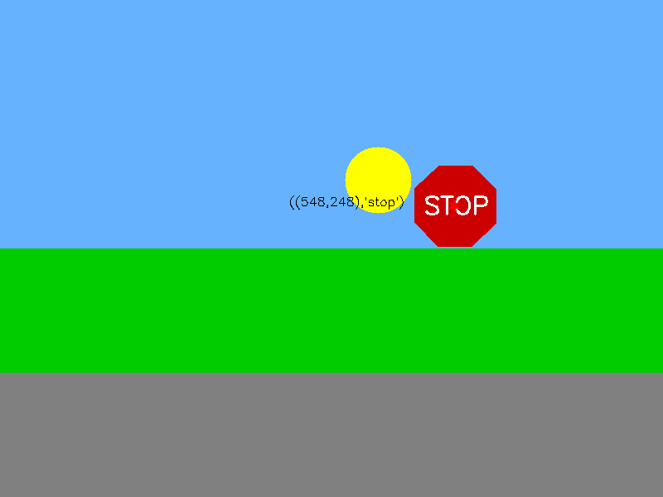
Traffic Sign Detection - Stop
Coordinates: 548, 248
ps2-2-a-2.png

Slide 9
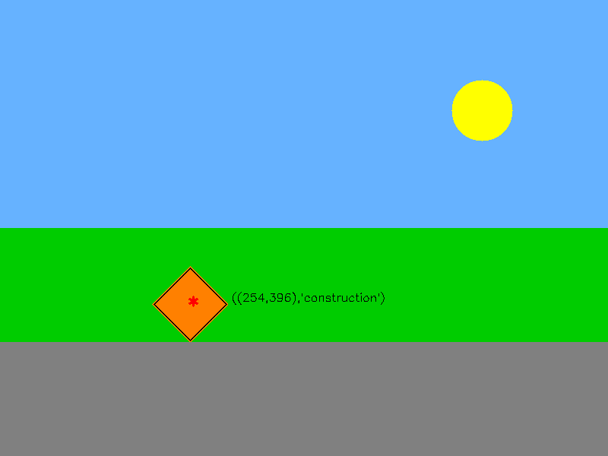
Traffic Sign Detection - Construction
Coordinates: 254, 396
ps2-2-a-3.png

Slide 10

Traffic Sign Detection - Warning
Coordinates: 751, 346
ps2-2-a-4.png

Slide 11

Traffic Sign Detection - Yield
Coordinates: 309, 188
ps2-2-a-5.png

Slide 12

Multiple sign detection
Coordinates and Name:
ps2-3-a-1.png

Slide 13
Multiple sign detection
Coordinates and Name:
ps2-3-a-2.png

Slide 14
Multiple sign detection with noise
Coordinates and Name:
ps2-4-a-1.png

Slide 15
Multiple sign detection with noise
Coordinates and Name:
ps2-4-a-2.png

Slide 16
Challenge problem - A
Coordinates and Name:
ps2-5-a-1

Slide 17
Challenge problem - A
Coordinates and Name:
ps2-5-a-2

Slide 18
Challenge problem - A
Coordinates and Name:
ps2-5-a-3

Slide 19
Challenge problem - B
Coordinates and Name:
ps2-5-b-1

Slide 20
Challenge problem - B
Coordinates and Name:
ps2-5-b-2

Slide 21
Challenge problem - B
Coordinates and Name:
ps2-5-b-3

Slide 22
Challenge problem - Text
Describe what you had to do to adapt your code for this task. How does the difference between simulated and real-world images affect your method? If you used other functions/methods, explain why that was better (or why your previous implementation did not work)

